Slide 1
KoTlin’s features to create a dsl
Part 1
Vova molin

Slide 2
Agenda
Why Kotlin
Comparison of Kotlin to Java
What is DSL
Features of Kotlin language to build DSL
A sample of DSL is built by using Kotlin

Slide 3

Is Java on the decline?

Slide 4
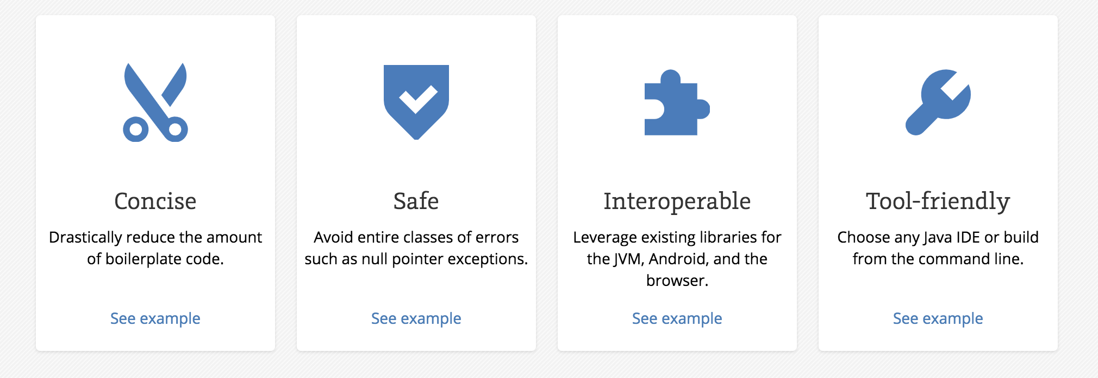
Why KotLin?

Slide 5
Some Java issues addressed in Kotlin
Null references are controlled by the type system
No raw types
Arrays in Kotlin are invariant
Kotlin has proper function types, as opposed to Java's SAM-conversions
Use-site variance without wildcards
Kotlin does not have checked exceptions

Slide 6
What Java has that Kotlin does not
Checked exceptions
Primitive types that are not classes
Static members
Non-private fields
Wildcard-types
Ternary-operator a ? b : c

Slide 7
What Kotlin has that Java does not
Lambda expressions + Inline functions = performant custom control structures
Extension functions
Null-safety
Smart casts
String templates
Properties
Primary constructors
First-class delegation
Type inference for variable and property types
Singletons
Declaration-site variance & Type projections
Range expressions
Operator overloading
Companion objects
Data classes
Separate interfaces for read-only and mutable collections
Coroutines

Slide 8
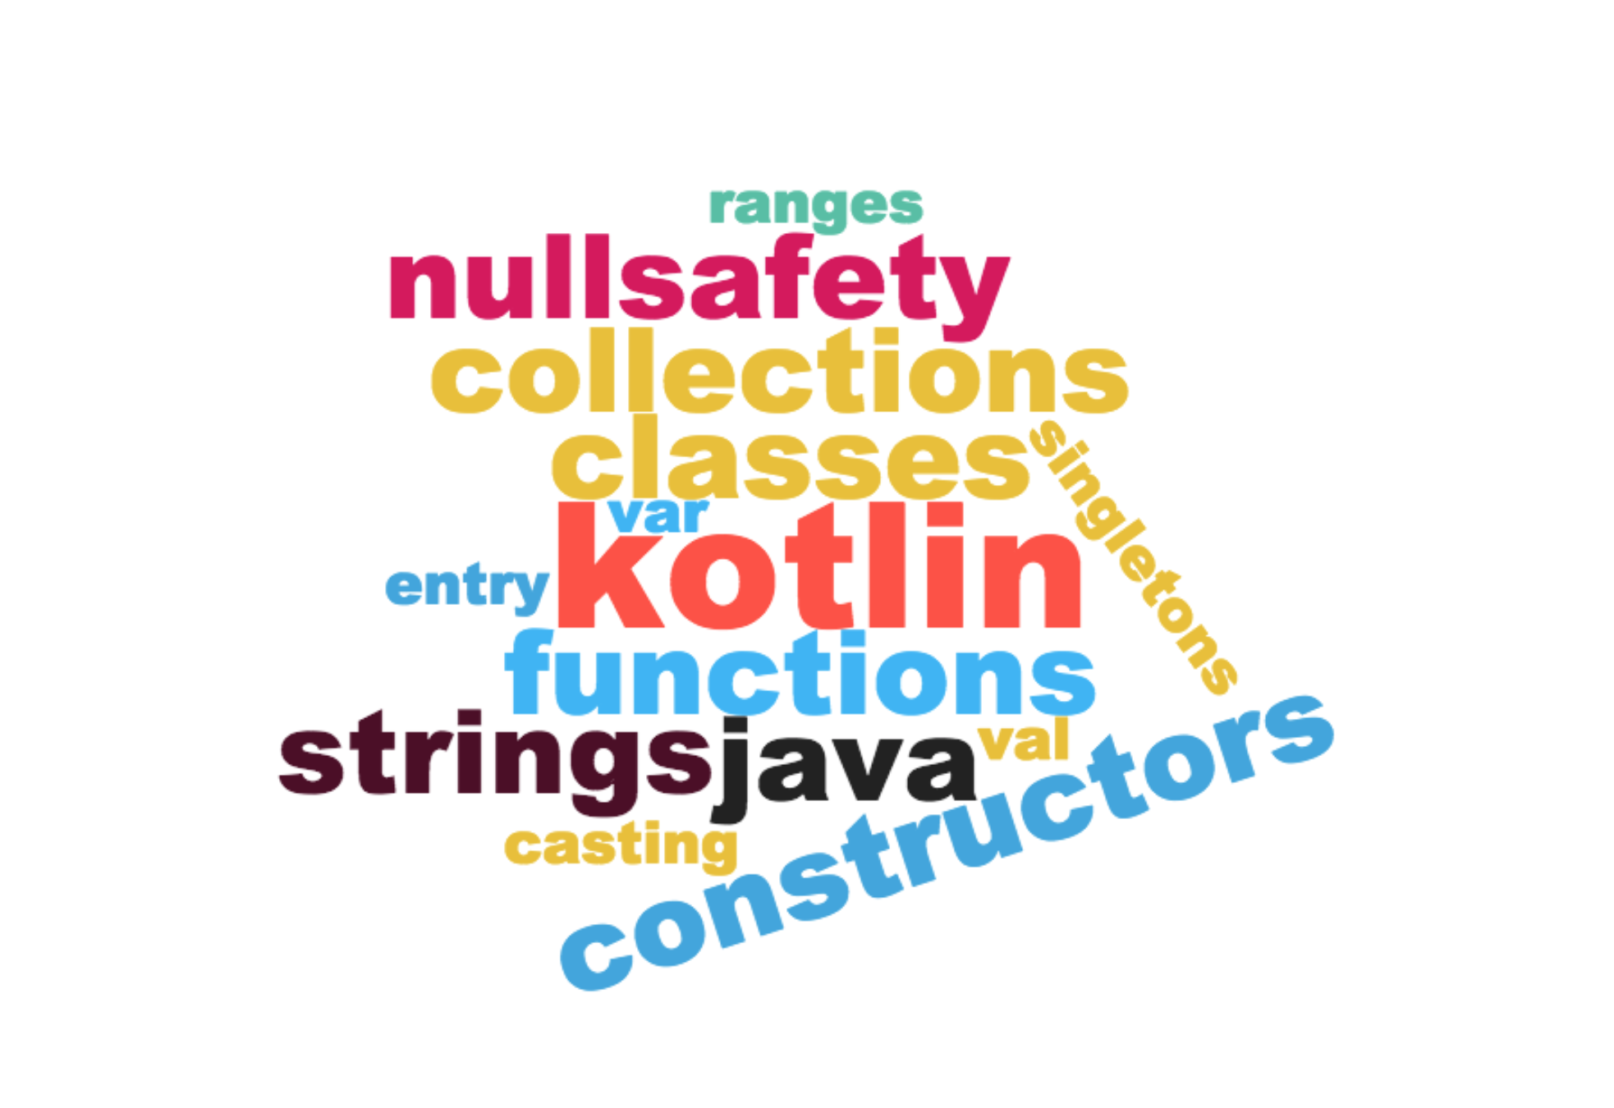
Wordcloud

Slide 9
demo

Slide 10
Where to learn and try Kotlin
Kotlin web site
Kotlin Koans
Kotlin Playground

Slide 11
KoTlin’s features to create a dsl
Part 1
Vova molin

Slide 12
KoTlin’s features to create a dsl
Part 2
Vova molin

Slide 13
What is DSL?
“The basic idea of a domain specific language (DSL) is a computer language that's targeted to a particular kind of problem, rather than a general purpose language that's aimed at any kind of software problem.”
-- Martin Fowler

Slide 14
What makes Kotlin special for internal DSL?

Slide 15
What makes Kotlin special for internal DSL?
Optional semicolons
Drop () and . using infix
Extension functions
Operator overloading
Functional literal with receiver

Slide 16
Demo time

Slide 17


to collide two trains into each other
Right
Goto
IfStop

Slide 18
KoTlin’s features to create a dsl
Part 2
Vova molin

